Slide 1
Convolution-Free Medical Image Segmentation using Transformers
Ajou Univ. software dep. 201920723 김동욱
Kim Dong Wook

Slide 2
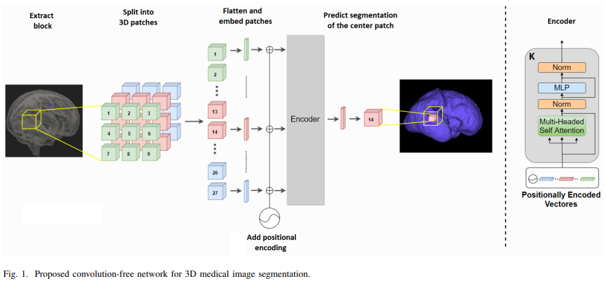
model

Slide 3
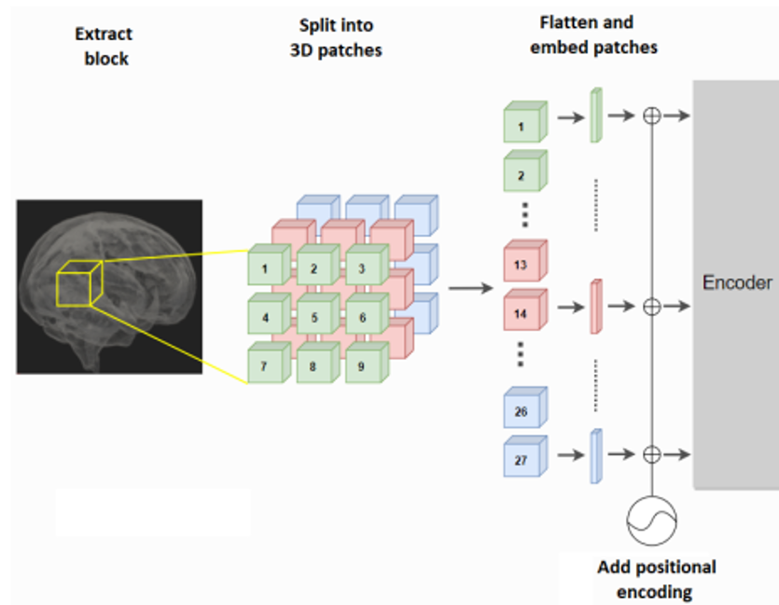
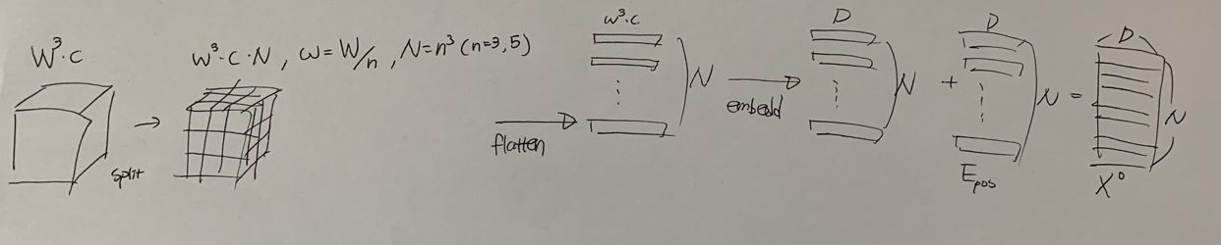
model

Slide 4
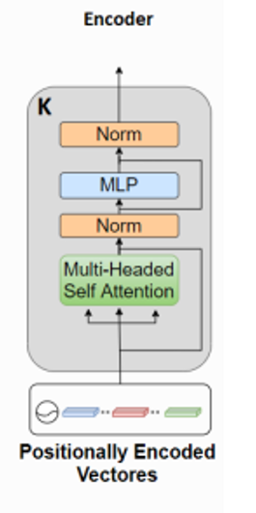
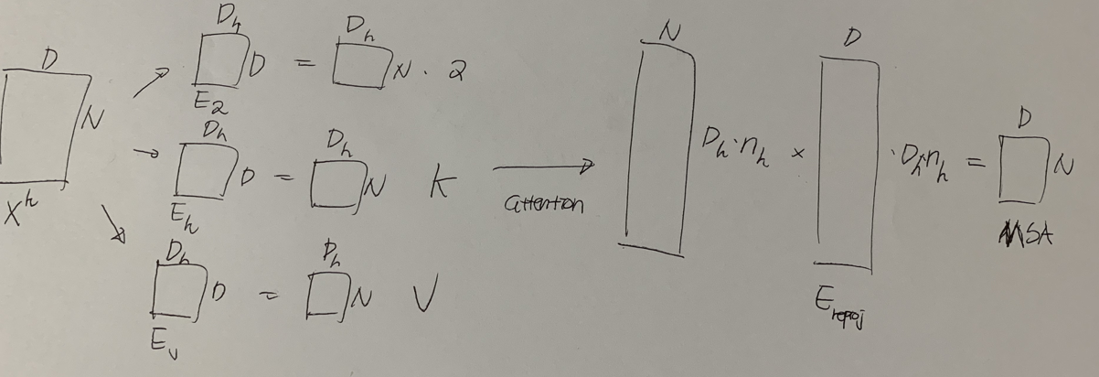
model

Slide 5
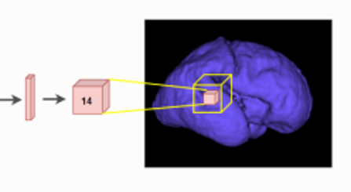

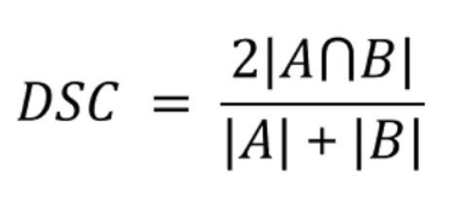
model, loss
Maximize dice similarity coefficient between Y and ground truth

Slide 6
train
Pre-train with unlabeled data for denoising or inpainting tasks
Used L2 Norm when pre-train
Fine tune with DSC

Slide 7
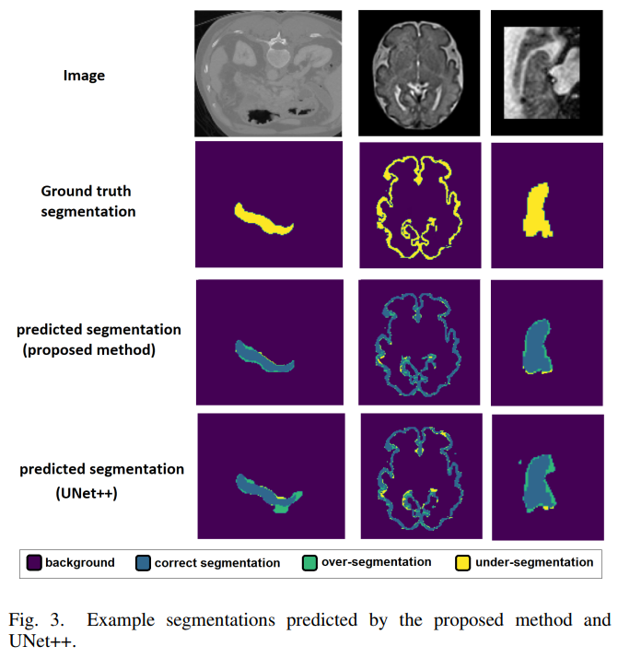
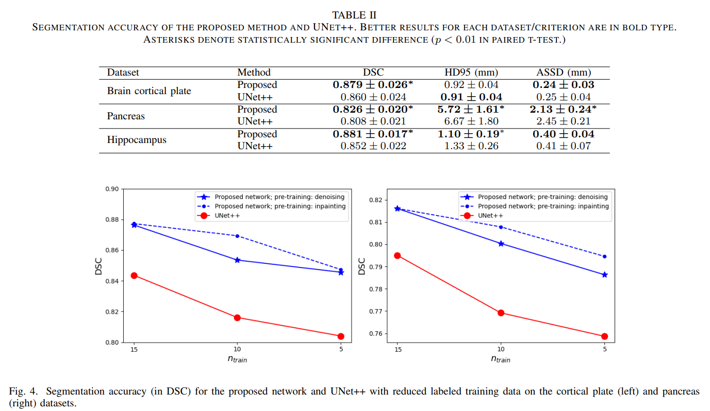
result

Slide 8
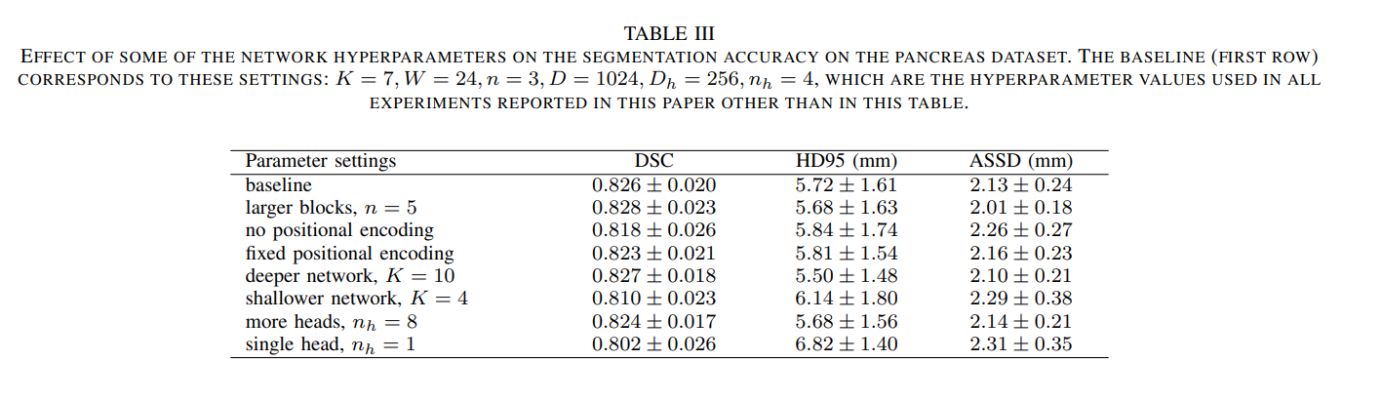
result

Slide 9
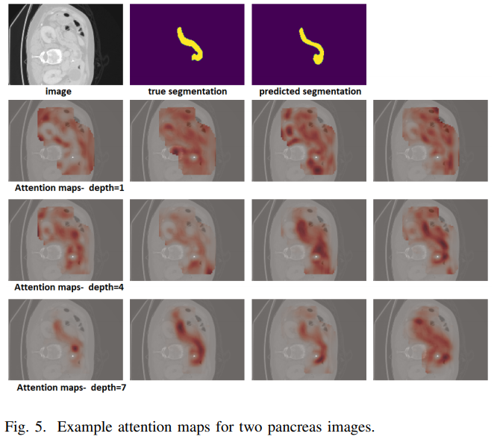
result

Slide 10
result
Better than sota(Unet++)
Very good performance with a fewer labeled data
No Convolution
Attention used

